Slide 1
FarmChainX AI-Driven Agricultural Traceability Network

Slide 2
PROBLEM STATEMENT
The current agricultural supply chain lacks transparency and proper traceability mechanisms. Agricultural products pass through multiple stages such as farming, processing, storage, and transportation, but there is no unified system to monitor and record each stage effectively. This creates risks of food fraud, mislabeling, and quality deterioration. Farmers often receive unfair pricing due to the involvement of multiple intermediaries and lack of visibility in the pricing structure. At the same time, consumers are unable to verify the origin, authenticity, and safety of the products they purchase, leading to reduced trust in the agricultural ecosystem.

Slide 3
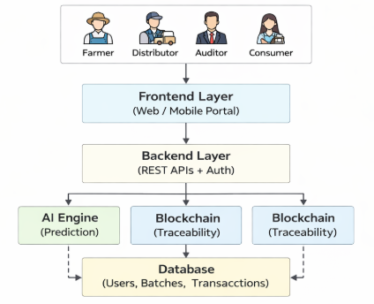
Architecture Diagram

Slide 4
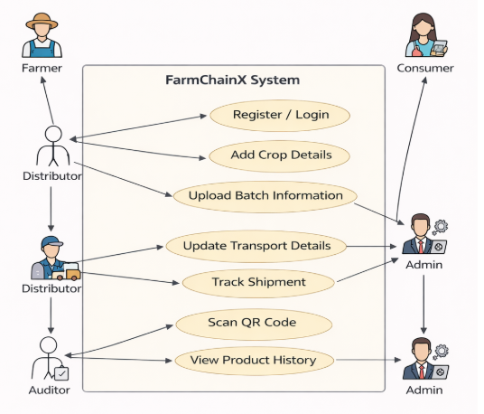
Use Case Diagram

Slide 5
Modules
Authentication & Authorization Module
Purpose: Secure system access
User registration & login
Role-based access control
JWT-based authentication
Batch Management Module
Purpose: Manage Crop Batches
Create and update batch
Assign ownership
Store batch details & AI results
User Management Module
Purpose: Manage system user
Create & update users
Activate / deactivate accounts
Admin control over users
Supply Chain Tracking Module
Purpose: Track movement of goods
Transfer batch (Farmer → Distributor → Retailer)
Maintain transaction logs
Update batch status

Slide 6
Modules
QR Code Module
Purpose: Enable public transparency
Generate QR code
Map QR to batch ID
Allow consumers to view history
AI Integration Module
Purpose: Intelligent prediction
Send batch data to ML model
Receive quality prediction
Store quality score

